Slide 1
NATURAL LANGUAGE PROCESSING
Dr. Lipika Dey
TCS Research and Innovation

Slide 2
What is NLP
Natural language processing (NLP) started in the 1950s as an area of research that wanted to facilitate Human Computer Interaction using natural languages that we speak
Aspects of Language
Coding and Implementation
Linguistics
Computer Science
Natural Language Processing
Artificial Intelligence
Information Engineering
Natural Language Understanding
Uncertainties and Vagueness
Solving the Task at hand
Natural Language Generation

Slide 3
Tasks
NLP - Attempt to decode language via syntactic and semantic identification to classify words and intent
Lexical analysis - break down text into paragraphs, sentences, and words.
Parsing - find out the grammatical structure of sentences.
Semantic analysis - dictionary meanings of words.
Discourse integration - makes sense of text meaning with context.
Pragmatic analysis - understand sentiment, intent and other intended information from text
NLU - maps language input into data that NLP can use - cracks the code of how language is arranged and transforms it into a machine-readable format
The river overflowed and the bank was ………..
The bank was ……. and the manager was killed.
NLG = generates text in machine-readable

Slide 4
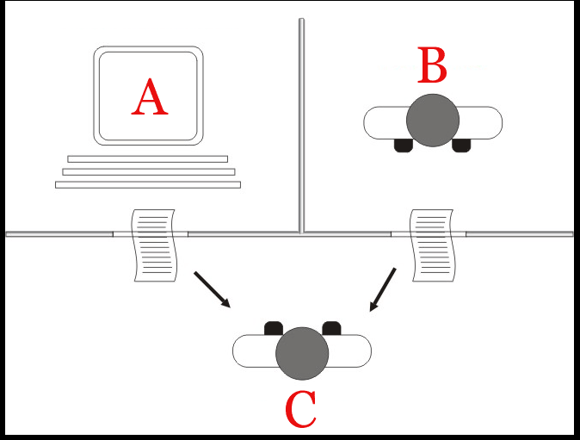
Turing Test
C - the interrogator, has to determine which player – A or B – is a computer and which is a human based on the responses to written questions

Slide 5
Why Natural Language Processing
To enable automated “characterization and understanding” of humongous Volumes of linguistic content generated at rapid Velocity in the form of conversations, writing, and other media
Needs
Understanding of the relationships between linguistic utterances and the world
Understanding of the linguistic structures by which language communicates
Some understanding about cognitive aspects of how humans acquire, produce, and understand language

Slide 6
What is your NLU application?
Responses from students
Smart assistant - Alexa, Siri - weather, sports, news, directions, voice commands for home automation
cannot understand all languages
can’t converse
syntactically correct commands only
can’t understand intent - expectation not met - ambiguity
doesn’t understand emotion of voice
Language Translator
Predictive typing - gmail
Email filter - spam / non-spam/ promotional
Text auto-correction -
Story completion game
Sentiment analysis - reviews of the product - features of the product
Summarization -
Entities and Relations Knowledge Graph – > Transactions → fraud?
Crime News - Semantic role Labeling
Question - Answering Systems

Slide 7
NLP and Text Processing Tasks
Extracting Drug names, disease names, product mentions, email ids,
addresses
Extracting Events / Sentiments Who did / said What, When, How, Why
How many negative reviews – on which aspect of product / service
Risk assessment – new policy about environment / health care / education
Information Extraction
Linguistic Analysis
Statistical Analysis
Drawing Inference
What are the causes a disease?
What is the policy for Paternity leave?
Summary of Financial obligations on signing a new contract with an alliance
General Purpose Conversation - Question
Understand & Empathize
Answer / Guide /Recommend
Any language to any language
Question Answering
Summarization
Natural Language generation
Machine Translation

Slide 8
Problem Solving

Slide 9
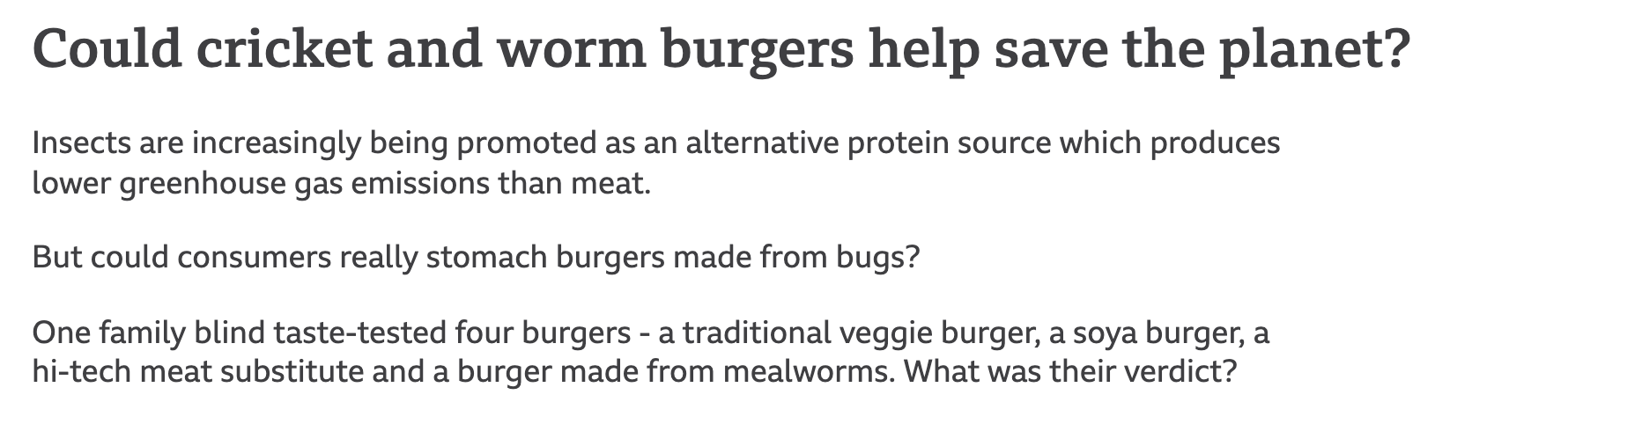
Information Retrieval
Given a query - retrieve relevant Documents -
Query to document mapping
Establishing Similarity -
How to measure similarity between two text documents?
Handling Synonyms, Homonyms
nearest hospital?
There is a “Pain management clinic” 5 miles from here
cricket news

Slide 10
Vector Space Model
Term vector space is a n-dimensional space, where n is the number of different terms/tokens used to represent a set of documents
Vector for document I is d_{i} , represented by a vector w_{ij}
Binary vector
w_{ij} > 0 if term j occurs in document i
w_{ij} = 0 otherwise

Slide 11
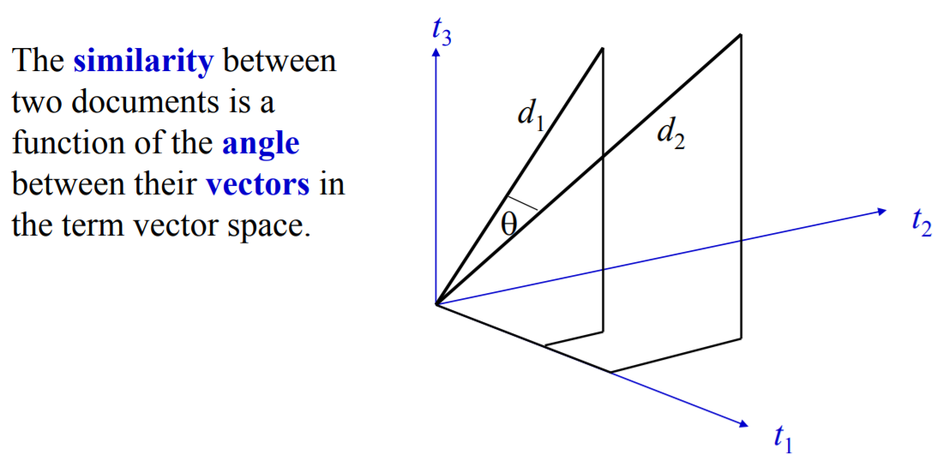
Similarity in Vector space
D1 – Ants eat sugar
D2 – Cows eat salt
D3 – Cows and ants are animals. They eat sugar
Ants | cows | animals | eat | salt | sugar | they
1 | 0 | 0 | 1 | 0 | 1 | 0
0 | 1 | 0 | 1 | 1 | 0 | 0
1 | 1 | 1 | 1 | 0 | 1 | 1

Slide 12
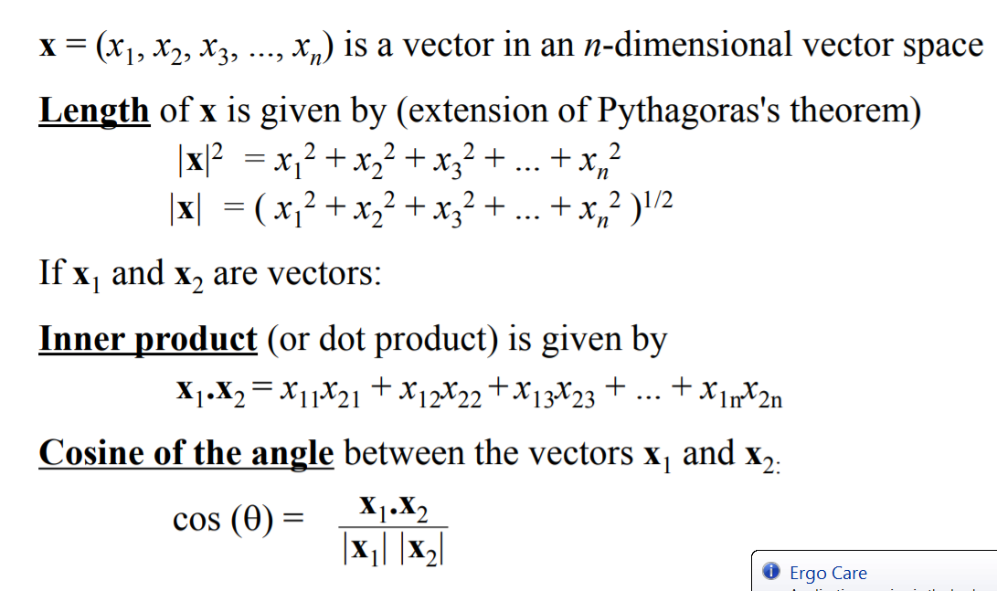
Computing Similarity

Slide 13
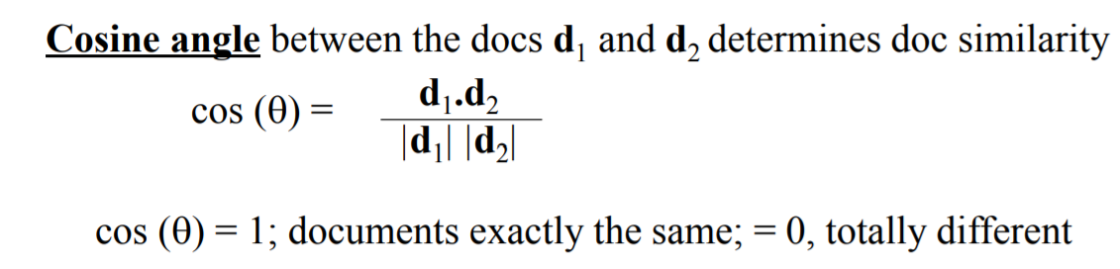
Cosine Similarity of Documents

Slide 14
Binary vector-based Similarity - example
Document | Ants | cows | animals | eat | salt | sugar | they | Length
D1 | 1 | 0 | 0 | 1 | 0 | 1 | 0
D2 | 0 | 1 | 0 | 1 | 1 | 0 | 0
D3 | 1 | 1 | 1 | 1 | 0 | 1 | 1
 | D1 | D2 | D3
D1 | 1 | 0.66
D2 | 0.66 | 1 | 0.47
D3 | 0.7 | 0.4 | 1

Slide 15
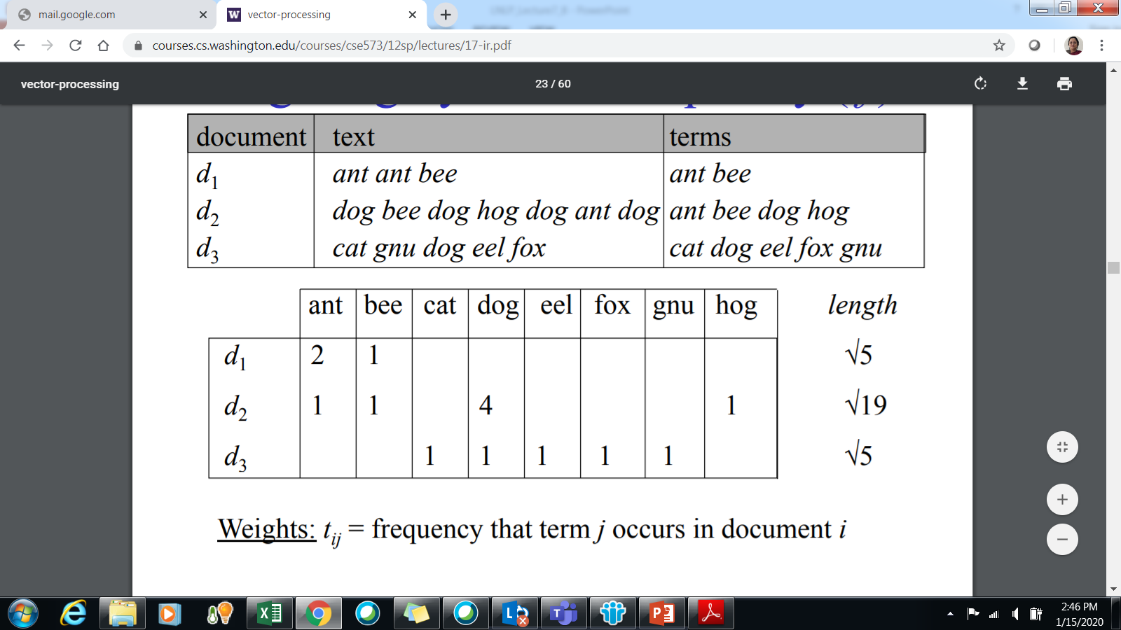
Term-frequency based approach
Words are repeated within a document – do they play a different role than the non-repeated ones?

Slide 16
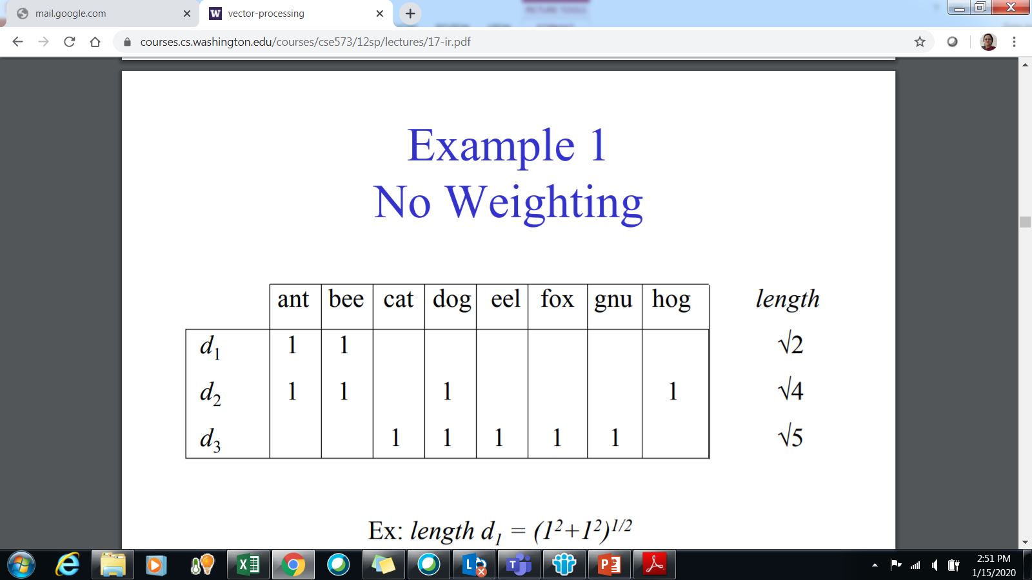
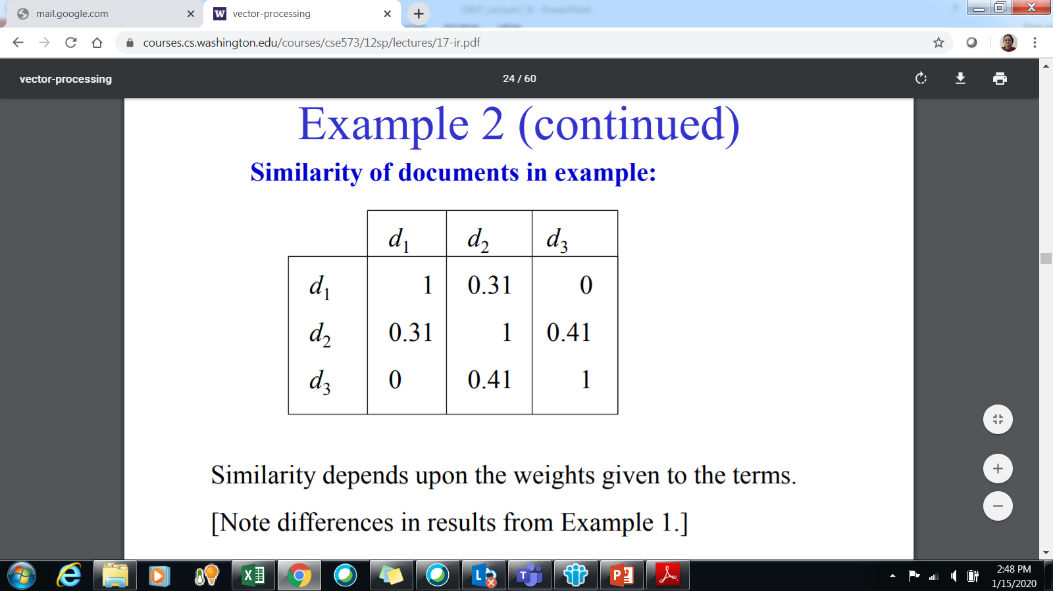
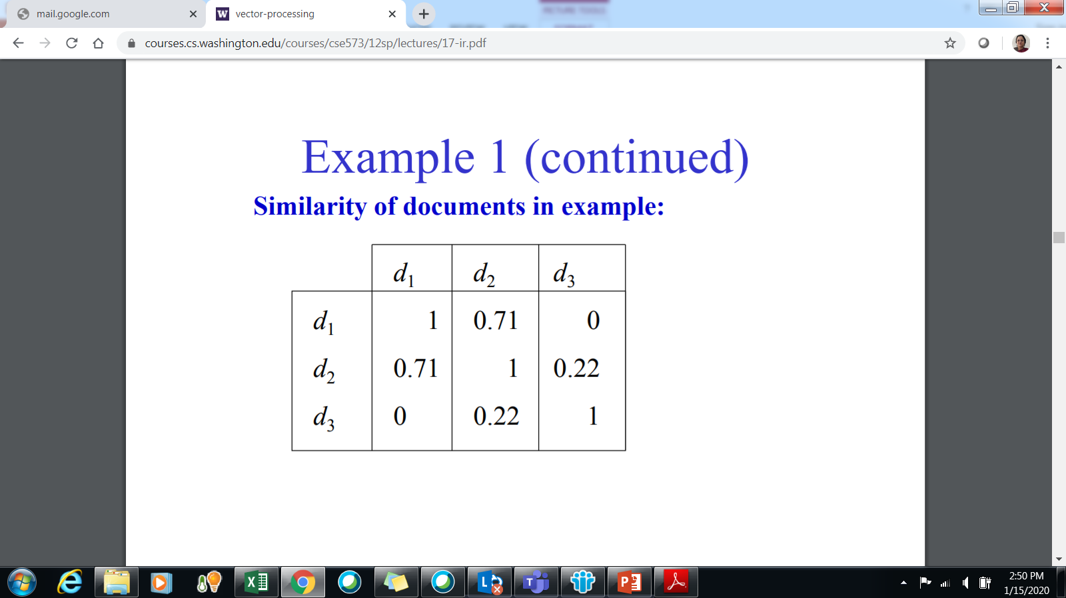
Binary Vector

Slide 17
Relatively important terms
Corpus – collection of documents
Frequent terms within a document are important indicators of their content
But most frequent terms are usually stop words
Their weightage needs to be reduced
Term Frequency
Weight of term within a document and corpus
Inverse Document Frequency
Can distinguish between frequent terms

Slide 18
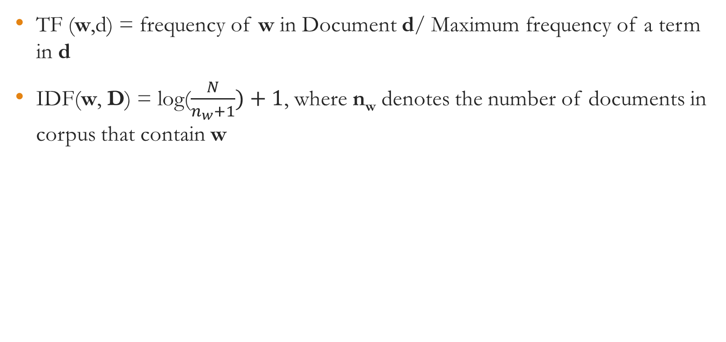
Computing TF-IDF
 | w1 | w2 | w3 |  |  | wn
d₁ | Tf(w₁,d₁) *IDF(w₁) |  |  |  |  | Tf(w_{n},d₁) *IDF(w_{n})
d₂ | TF(w₁,d₂)*IDF(w₁) |  |  |  |  | Tf(w_{n},d₂) *IDF(w_{n})
d_{N} | TF(w₁,d_{N})*IDF(w₁) |  |  |  |  | Tf(w_{n},d_{N}) *IDF(w_{n})

Slide 19
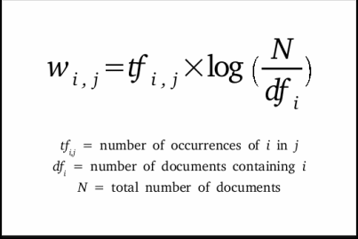
Massaging text inputs
Should we take all words?
Top words
TF – Idf
Fox – 1
As - 7
Fox – 0
As - 5
Fox – 2
As - 3
Dimensionality Reduction
As doesn’t make it to the list of top words
Doc | Fox | As
1 | 2 * log(3/2) | 3*log(3/3) = 0
2 | 0*log(3/2) | 5*log(3/3) = 0
3 | 1*log(3/2) | 7*log(3/3) = 0

Slide 20
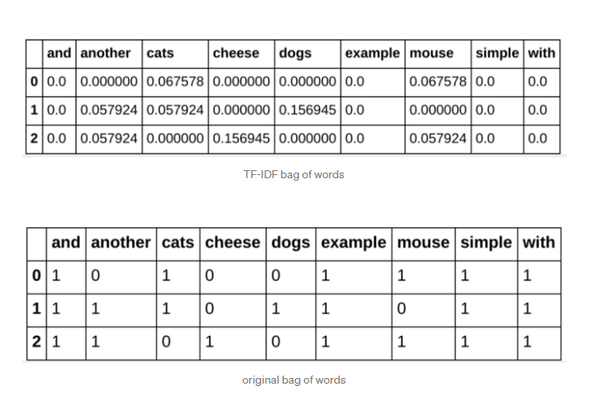
How it makes a difference

Slide 21
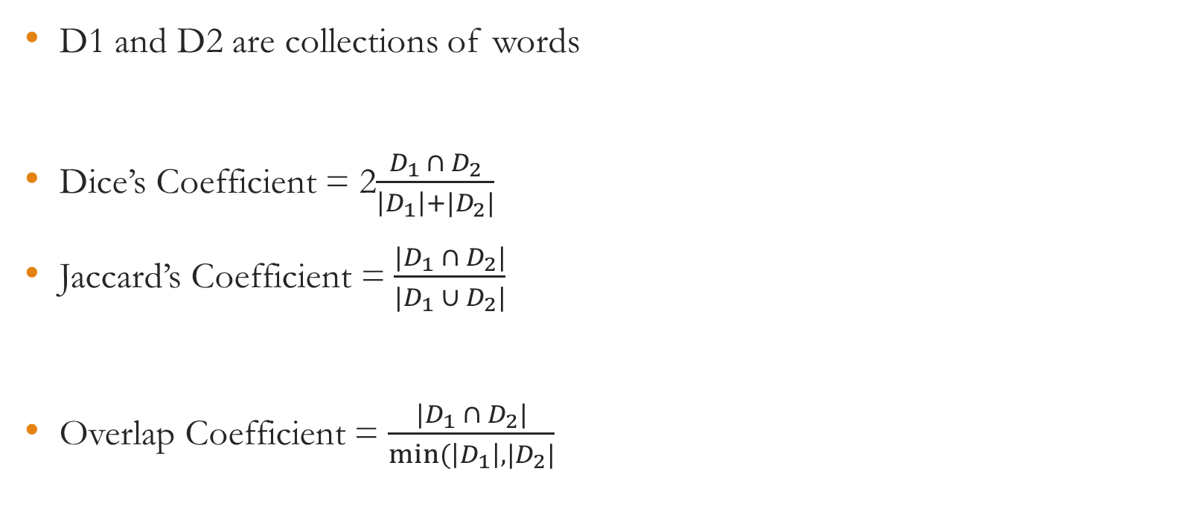
Other Similarity Measures

Slide 22
TF - IDF
What happens to Stop Words?
What happens to Rare words?
Why is it called Bag of Words model?

Slide 23
Other applications
What kinds of things do people say?
How are they saying?
What do these things say/ask/request about the world?
I woke up early morning 5 AM, for running, After complete my running, I go to the kitchen to make my self an orange juice, So I pligged in the cable and switch on the machine, But when I toughed the machine I feel very high electric shock! I step back and off the switch with a wooden stick. I thought it might be an electrical problem, But after an hour my mother also shocked by this juicer. I called to the shopkeeper. The shopkeeper is a nice guy, So he helped me out with this problem. So this juicer is very dangerous for every one, So u can't take this juicer.
Words
Word sequences
Structures
Patterns from Corpus
Semantics
Linking words to World
Discourse

Slide 24
Going deeper - Processing multiple documents
User Review1 - "Canon's optics are better than those of Sony and Nikon"
User Review2 - “If you are planning to buy a camera - I would say Sony is a better choice, since they have service centers in all big cities. But Canon definitely takes better pictures.”
User Review3 - I had a horrible experience with Amazon. I had ordered for a Canon EOS. I wanted to gift it to my girlfriend for her birthday. At the last moment they didn’t deliver it so my girlfriend broke up with me. So I kept it with me. I have to say that the Canon EOS is excellent but Amazon sucks! I wrote to the CEO. He didn’t even bother to reply.”
Who is saying what about what?
Which is better than which about what?
What is the overall sentiment about Sony, Canon and Nikon cameras?
What is the overall sentiment about Sony, Canon, Nikon, Amazon?

Slide 25
Sentiment Analysis using Text Classification
Input Movie Review 🡪 Good / Bad
“I hate this product” 🡪 Happy / Sad / Angry
The first wave was bad, but the second wave was devastating. - strength or valence of emotion
Could be at document level or sentence level

Slide 26
Complex Requirements
Names of organizations, places, people
Named Entities - Sony, Canon, Amazon, CEO
Object Mentions
camera, not delivered, girl friend
Opinion words
Good, better, happy
Subject of Opinion
canon’s optics, Sony’s service centers
Deep Dive into Text
Proper Nouns
Nouns
Verbs
Adjectives
Phrases
Pronouns

Slide 27
LINGUISTIC ESSENTIALS

Slide 28
Parts of Speech and Morphology
Words of a language belong to different classes
Each class exhibits a distinct behavior
Distinct syntactic behavior
Typical semantic behavior
Also referred to as Parts of speech (POS)

Slide 29
Phrase structure
Language puts constraint on the order of words in a sentence
book this prepared material have Manning’s from I
I have prepared this material from Manning’s book
This material, I have prepared from Manning’s book
From Manning’s book I have prepared this material
Prepared this material I have from Manning’s book
I have placed an order with the boy who sells flowers at the railway station

Slide 30
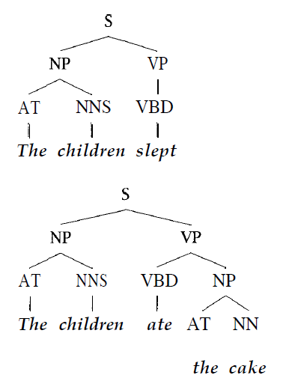
Phrase structure grammar
A syntactic analysis of a sentence tells us how to determine the meaning of the sentence from the meaning of the words
Peter gave a book to Mary
Mary gave a book to Peter
Order matters
Phrase tree helps in understanding the structure

Slide 31
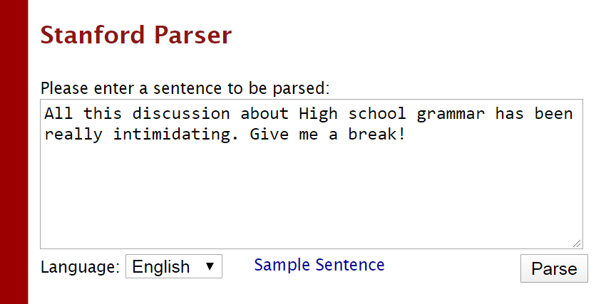
Tagging
All/PDT this/DT discussion/NN about/IN High/JJ school/NN grammar/NN has/VBZ been/VBN really/RB intimidating/JJ ./.
Give/VB me/PRP a/DT break/NN !/.

Slide 32
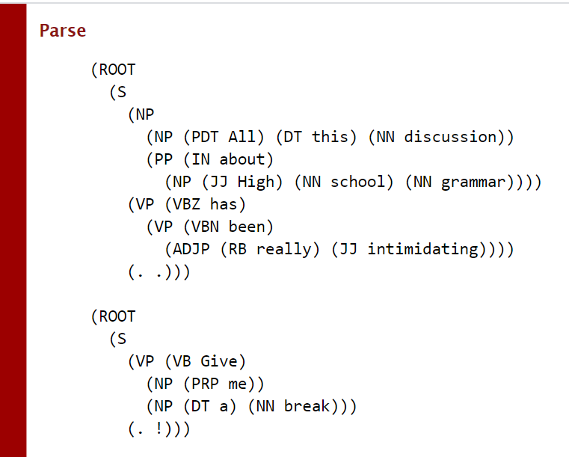

Slide 33
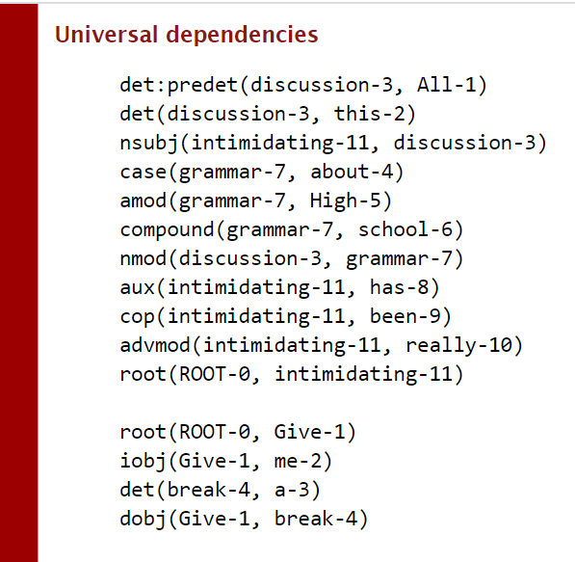

Slide 34
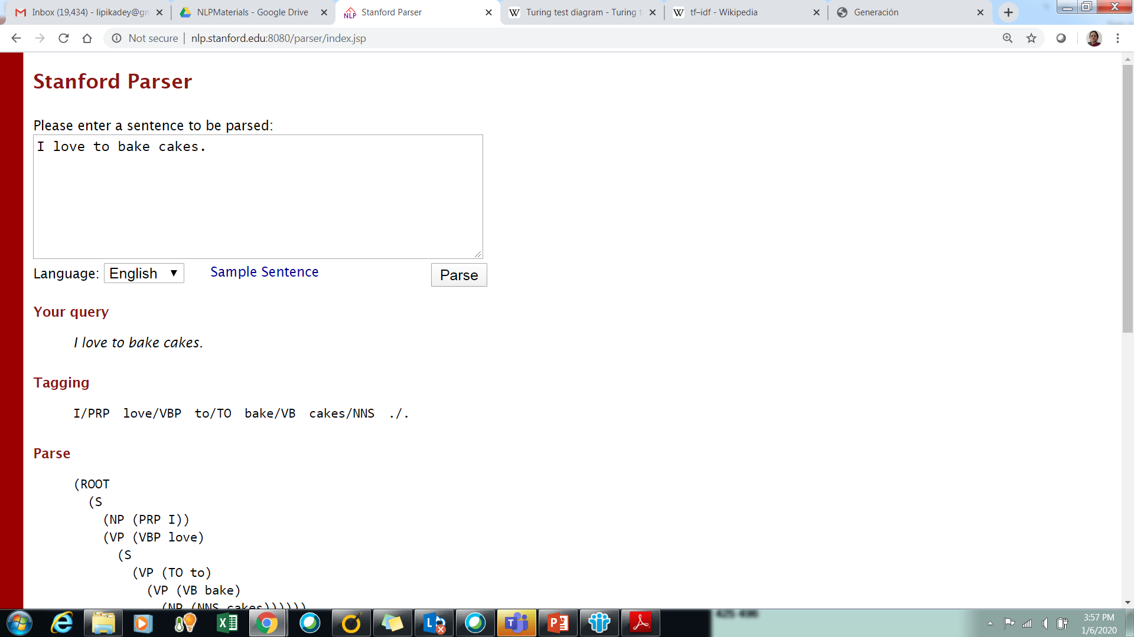
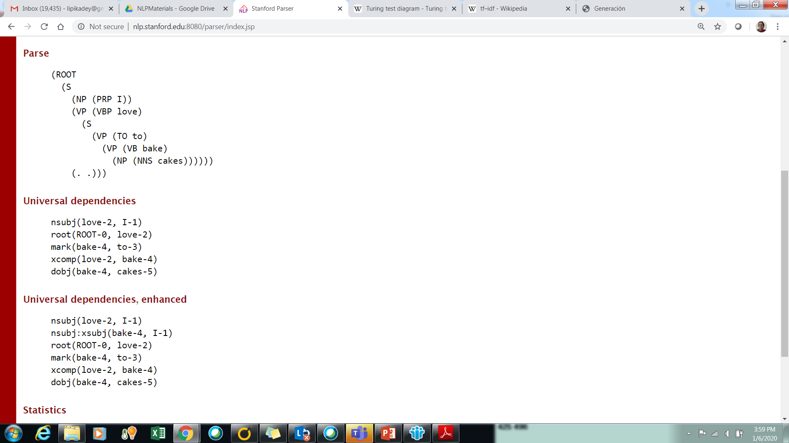
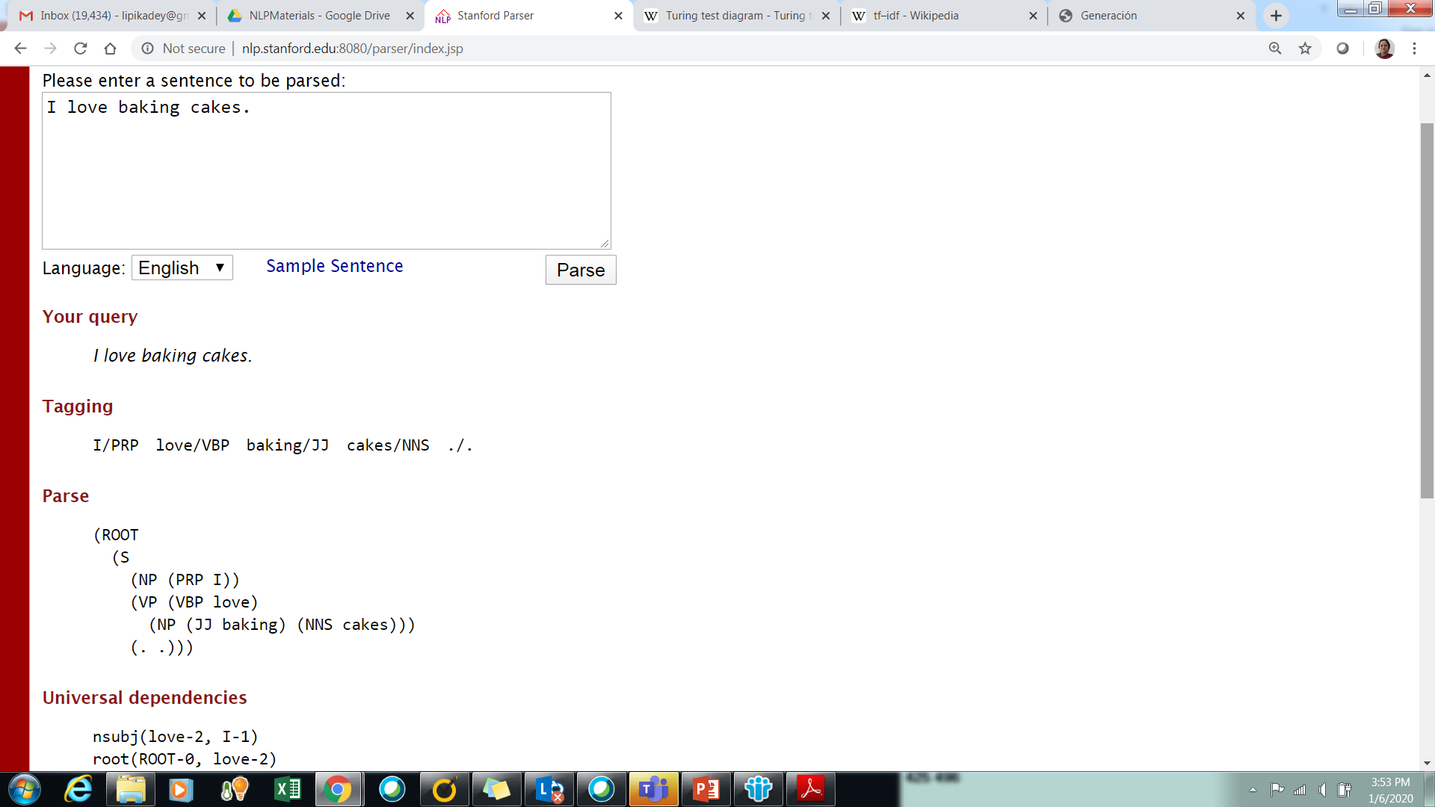
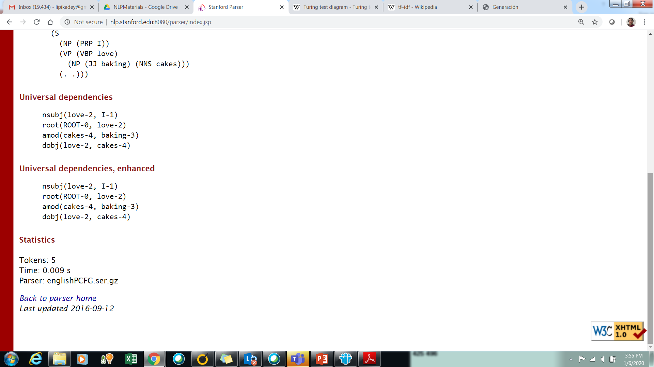
How reliable?
I love baking cakes.
I love to bake cakes.

Slide 35
Common POS
Noun
names of people / place /organizations /concepts
Verb
Express action
Adjective
Describe properties of Noun

Slide 36
Named Entity Recognition
Seeks to locate and classify elements in text into pre-defined categories such as names of persons, organizations, locations, expressions of times, quantities, monetary values, percentages, etc.
NER is used in many fields in Natural Language Processing (NLP), and it can help answering many real-world questions, such as:
Which companies were mentioned in the news article?
Were specified products mentioned in complaints or reviews?
Does the tweet contain the name of a person? Does the tweet contain this person’s location?

Slide 37
Pronouns and Determiners
Pronouns are a class of words that act like variables
They refer to a person or thing that is important in the discourse context
I have bought the new Tata Tigor. It’s a marvelous car with smooth pick-up.
My daughter wanted a new car. We chose the new Renault Kwid. It’s the perfect car for her
The lazy fox jumped over the blue moon

Slide 38
Adverbs, Prepositions, Particles
What do you think of my dress?
It’s good.
It’s very nice!
It’s bad!
It’s not bad! Adverb makes a difference
I sit on the bench but wade in water – spatial relationships
Particles are a subclass of prepositions that enter into strong bonds with verbs to create PHRASAL VERBS that become separate lexical entry
I was put off by the remarks

Slide 39


Text Classification
Training Data - Create Annotated training Samples
Train a classifier - Bayesian Classifier, SVM, Neural Network
Features - words, Noun/verb words/ phrases / ngrams
For new samples - apply classifier
Evaluate
Challenges - Right or Wrong?
Text Ambiguity
I have never tasted a cake quite like that one before!
Ambiguity: Was the cake good or bad?
Punctuations matter - but people forget them especially on Social Meda
I’m sorry I love you!
I’m sorry; I love you!

Slide 40

Text Annotation and Evaluation
Difficult challenges - no absolute measure of correctness
Yet machines have to be judged by humans
Is this a good translation?
Next lecture - how are these issues handled?

